Slide 1
TST12188 4vs4 and 3vs3 comparison RNAseq study of SMN2 splice-modulator lead compounds
Zhen Gao
09/22/2023

Slide 2
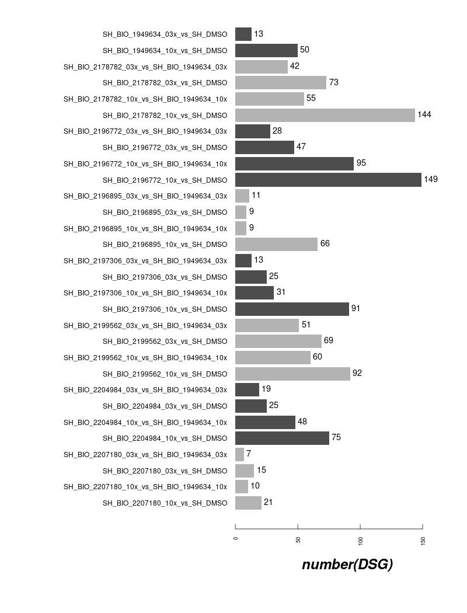
DSG Counts in ShSy5Y off-Targets (7 compounds and risdiplam) 3vs3 dPS-and max( abs(dPSI))
3vs3
Max(dPSI)
3vs3
max(abs(dPSI))

Slide 3
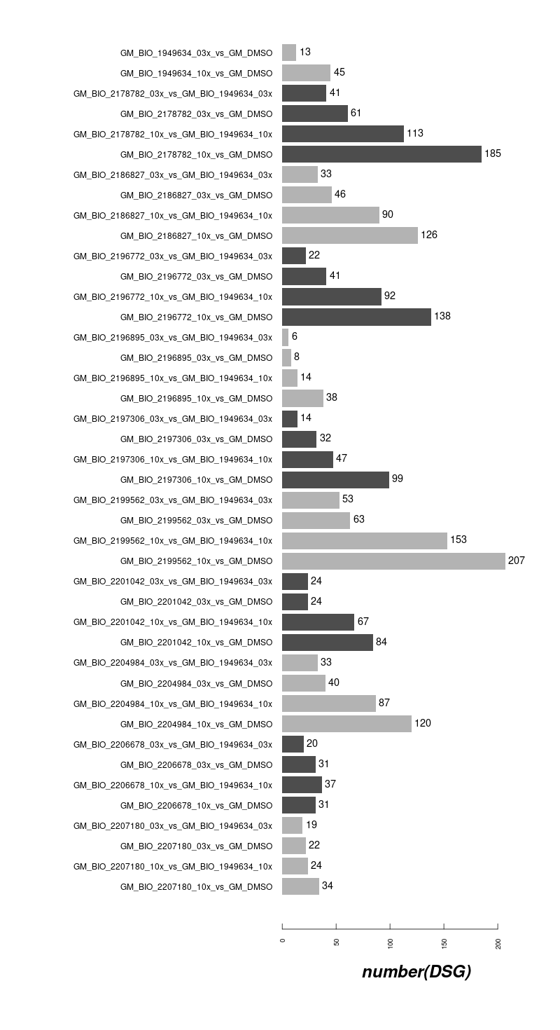
DSG Counts in GM09677c SMA fibroblasts off-Targets (10 compounds and risdiplam) 3vs3 max and ABS
3vs3
Max(dPSI)
3vs3
Max_ABS

Slide 4
DSG dPSI in ShSy5Y on-Targets
7 compounds/Risdiplam vs DMSO:
7 compounds(2 different doses) vs Risdiplam:
Comparison | HTT | SMN1 | SMN2
dPSI_SH_BIO_1949634_10x_vs_SH_DMSO | NA | -0.2526652 | -0.3973348
dPSI_SH_BIO_1949634_03x_vs_SH_DMSO | NA | NA | -0.3357675
dPSI_SH_BIO_2178782_10x_vs_SH_DMSO | 0.30961904 | 0.3746 | -0.3718549
dPSI_SH_BIO_2178782_03x_vs_SH_DMSO | -0.3768796 | 0.4252 | -0.3774074
dPSI_SH_BIO_2196772_10x_vs_SH_DMSO | 0.51446095 | -0.25527 | -0.3969779
dPSI_SH_BIO_2196772_03x_vs_SH_DMSO | 0.27077417 | 0.3761 | -0.3575137
dPSI_SH_BIO_2196895_10x_vs_SH_DMSO | -0.3125544 | 0.4767 | -0.3901281
dPSI_SH_BIO_2196895_03x_vs_SH_DMSO | NA | NA | -0.2865837
dPSI_SH_BIO_2197306_10x_vs_SH_DMSO | 0.38282796 | 0.4767 | -0.3888403
dPSI_SH_BIO_2197306_03x_vs_SH_DMSO | NA | NA | -0.3108891
dPSI_SH_BIO_2199562_10x_vs_SH_DMSO | 0.47217337 | 0.3791 | -0.3606088
dPSI_SH_BIO_2199562_03x_vs_SH_DMSO | 0.2825576 | NA | -0.3230936
dPSI_SH_BIO_2204984_10x_vs_SH_DMSO | -0.3590067 | 0.3925 | -0.3594403
dPSI_SH_BIO_2204984_03x_vs_SH_DMSO | NA | NA | NA
dPSI_SH_BIO_2207180_10x_vs_SH_DMSO | NA | NA | -0.2673572
dPSI_SH_BIO_2207180_03x_vs_SH_DMSO | NA | NA | NA
Comparison | HTT | SMN1 | SMN2
dPSI_SH_BIO_2178782_10x_vs_SH_BIO_1949634_10x | NA | NA | NA
dPSI_SH_BIO_2178782_03x_vs_SH_BIO_1949634_03x | -0.4 | NA | NA
dPSI_SH_BIO_2196772_10x_vs_SH_BIO_1949634_10x | 0.39 | NA | NA
dPSI_SH_BIO_2196772_03x_vs_SH_BIO_1949634_03x | 0.26 | NA | NA
dPSI_SH_BIO_2196895_10x_vs_SH_BIO_1949634_10x | NA | NA | NA
dPSI_SH_BIO_2196895_03x_vs_SH_BIO_1949634_03x | NA | NA | NA
dPSI_SH_BIO_2197306_10x_vs_SH_BIO_1949634_10x | 0.27 | NA | NA
dPSI_SH_BIO_2197306_03x_vs_SH_BIO_1949634_03x | NA | NA | NA
dPSI_SH_BIO_2199562_10x_vs_SH_BIO_1949634_10x | 0.32 | NA | NA
dPSI_SH_BIO_2199562_03x_vs_SH_BIO_1949634_03x | 0.27 | NA | NA
dPSI_SH_BIO_2204984_10x_vs_SH_BIO_1949634_10x | -0.3 | NA | NA
dPSI_SH_BIO_2204984_03x_vs_SH_BIO_1949634_03x | NA | NA | NA
dPSI_SH_BIO_2207180_10x_vs_SH_BIO_1949634_10x | NA | NA | NA
dPSI_SH_BIO_2207180_03x_vs_SH_BIO_1949634_03x | NA | NA | NA

Slide 5
DSG dPSI in ShSy5Y on-Targets
7 compounds/Risdiplam vs DMSO:
max(abs(dPSI))
Comparison | HTT | SMN1 | SMN2
dPSI_SH_BIO_1949634_10x_vs_SH_DMSO | NA | -0.2526652 | -0.3973348
dPSI_SH_BIO_1949634_03x_vs_SH_DMSO | NA | NA | -0.3357675
dPSI_SH_BIO_2178782_10x_vs_SH_DMSO | 0.30961904 | 0.3746 | -0.3718549
dPSI_SH_BIO_2178782_03x_vs_SH_DMSO | -0.3768796 | 0.4252 | -0.3774074
dPSI_SH_BIO_2196772_10x_vs_SH_DMSO | 0.51446095 | -0.25527 | -0.3969779
dPSI_SH_BIO_2196772_03x_vs_SH_DMSO | 0.27077417 | 0.3761 | -0.3575137
dPSI_SH_BIO_2196895_10x_vs_SH_DMSO | -0.3125544 | 0.4767 | -0.3901281
dPSI_SH_BIO_2196895_03x_vs_SH_DMSO | NA | NA | -0.2865837
dPSI_SH_BIO_2197306_10x_vs_SH_DMSO | 0.38282796 | 0.4767 | -0.3888403
dPSI_SH_BIO_2197306_03x_vs_SH_DMSO | NA | NA | -0.3108891
dPSI_SH_BIO_2199562_10x_vs_SH_DMSO | 0.47217337 | 0.3791 | -0.3606088
dPSI_SH_BIO_2199562_03x_vs_SH_DMSO | 0.2825576 | NA | -0.3230936
dPSI_SH_BIO_2204984_10x_vs_SH_DMSO | -0.3590067 | 0.3925 | -0.3594403
dPSI_SH_BIO_2204984_03x_vs_SH_DMSO | NA | NA | NA
dPSI_SH_BIO_2207180_10x_vs_SH_DMSO | NA | NA | -0.2673572
dPSI_SH_BIO_2207180_03x_vs_SH_DMSO | NA | NA | NA
Comparison | HTT | SMN1 | SMN2
dPSI_SH_BIO_1949634_10x_vs_SH_DMSO | NA | -0.2526652 | -0.3973348
dPSI_SH_BIO_1949634_03x_vs_SH_DMSO | NA | NA | -0.3357675
dPSI_SH_BIO_2178782_10x_vs_SH_DMSO | 0.58181829 | 0.3746 | -0.3718549
dPSI_SH_BIO_2178782_03x_vs_SH_DMSO | -0.3768796 | 0.4252 | -0.3774074
dPSI_SH_BIO_2196772_10x_vs_SH_DMSO | 0.84293755 | -0.25527 | -0.3969779
dPSI_SH_BIO_2196772_03x_vs_SH_DMSO | 0.27077417 | 0.3761 | -0.3575137
dPSI_SH_BIO_2196895_10x_vs_SH_DMSO | -0.3125544 | 0.4767 | -0.3901281
dPSI_SH_BIO_2196895_03x_vs_SH_DMSO | NA | NA | -0.2865837
dPSI_SH_BIO_2197306_10x_vs_SH_DMSO | 0.38282796 | 0.4767 | -0.3888403
dPSI_SH_BIO_2197306_03x_vs_SH_DMSO | NA | NA | -0.3108891
dPSI_SH_BIO_2199562_10x_vs_SH_DMSO | 0.47217337 | 0.3791 | -0.3606088
dPSI_SH_BIO_2199562_03x_vs_SH_DMSO | 0.2825576 | NA | -0.3230936
dPSI_SH_BIO_2204984_10x_vs_SH_DMSO | -0.3590067 | 0.3925 | -0.3594403
dPSI_SH_BIO_2204984_03x_vs_SH_DMSO | NA | NA | NA
dPSI_SH_BIO_2207180_10x_vs_SH_DMSO | NA | NA | -0.2673572
dPSI_SH_BIO_2207180_03x_vs_SH_DMSO | NA | NA | NA

Slide 6
DSG dPSI in ShSy5Y on-Targets
7 compounds(2 different doses) vs Risdiplam:
Comparison | HTT | SMN1 | SMN2
dPSI_SH_BIO_2178782_10x_vs_SH_BIO_1949634_10x | NA | NA | NA
dPSI_SH_BIO_2178782_03x_vs_SH_BIO_1949634_03x | -0.4 | NA | NA
dPSI_SH_BIO_2196772_10x_vs_SH_BIO_1949634_10x | 0.39 | NA | NA
dPSI_SH_BIO_2196772_03x_vs_SH_BIO_1949634_03x | 0.26 | NA | NA
dPSI_SH_BIO_2196895_10x_vs_SH_BIO_1949634_10x | NA | NA | NA
dPSI_SH_BIO_2196895_03x_vs_SH_BIO_1949634_03x | NA | NA | NA
dPSI_SH_BIO_2197306_10x_vs_SH_BIO_1949634_10x | 0.27 | NA | NA
dPSI_SH_BIO_2197306_03x_vs_SH_BIO_1949634_03x | NA | NA | NA
dPSI_SH_BIO_2199562_10x_vs_SH_BIO_1949634_10x | 0.32 | NA | NA
dPSI_SH_BIO_2199562_03x_vs_SH_BIO_1949634_03x | 0.27 | NA | NA
dPSI_SH_BIO_2204984_10x_vs_SH_BIO_1949634_10x | -0.3 | NA | NA
dPSI_SH_BIO_2204984_03x_vs_SH_BIO_1949634_03x | NA | NA | NA
dPSI_SH_BIO_2207180_10x_vs_SH_BIO_1949634_10x | NA | NA | NA
dPSI_SH_BIO_2207180_03x_vs_SH_BIO_1949634_03x | NA | NA | NA
Comparison | HTT | SMN1 | SMN2
dPSI_SH_BIO_2178782_10x_vs_SH_BIO_1949634_10x | NA | NA | NA
dPSI_SH_BIO_2178782_03x_vs_SH_BIO_1949634_03x | -0.357 | NA | NA
dPSI_SH_BIO_2196772_10x_vs_SH_BIO_1949634_10x | 0.792 | NA | NA
dPSI_SH_BIO_2196772_03x_vs_SH_BIO_1949634_03x | 0.258 | NA | NA
dPSI_SH_BIO_2196895_10x_vs_SH_BIO_1949634_10x | NA | NA | NA
dPSI_SH_BIO_2196895_03x_vs_SH_BIO_1949634_03x | NA | NA | NA
dPSI_SH_BIO_2197306_10x_vs_SH_BIO_1949634_10x | 0.422 | NA | NA
dPSI_SH_BIO_2197306_03x_vs_SH_BIO_1949634_03x | NA | NA | NA
dPSI_SH_BIO_2199562_10x_vs_SH_BIO_1949634_10x | 0.536 | NA | NA
dPSI_SH_BIO_2199562_03x_vs_SH_BIO_1949634_03x | 0.270 | NA | NA
dPSI_SH_BIO_2204984_10x_vs_SH_BIO_1949634_10x | -0.303 | NA | NA
dPSI_SH_BIO_2204984_03x_vs_SH_BIO_1949634_03x | NA | NA | NA
dPSI_SH_BIO_2207180_10x_vs_SH_BIO_1949634_10x | NA | NA | NA
dPSI_SH_BIO_2207180_03x_vs_SH_BIO_1949634_03x | NA | NA | NA

Slide 7
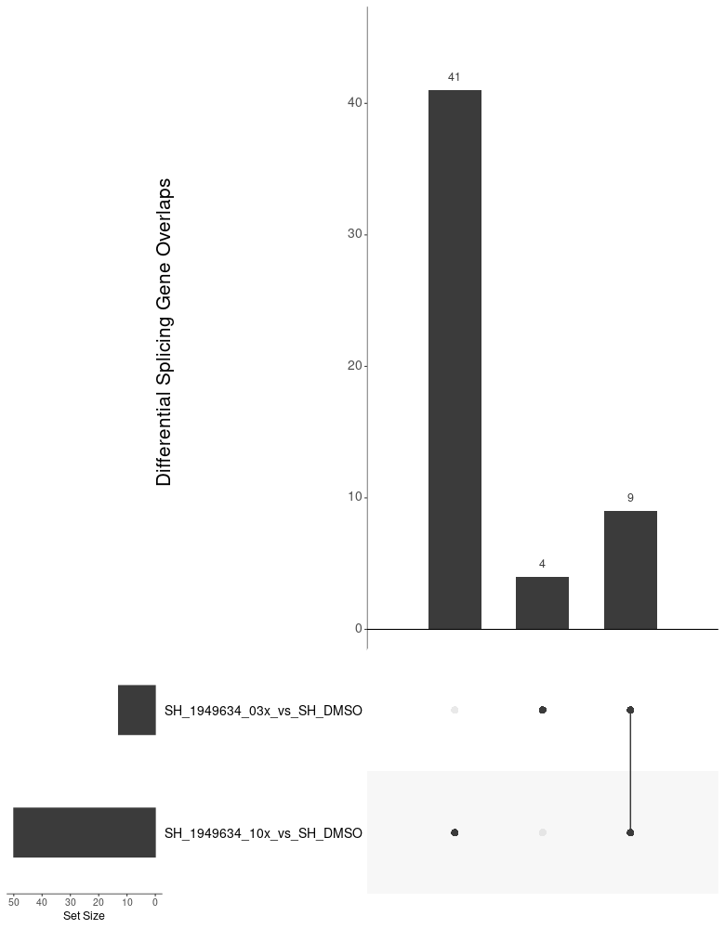
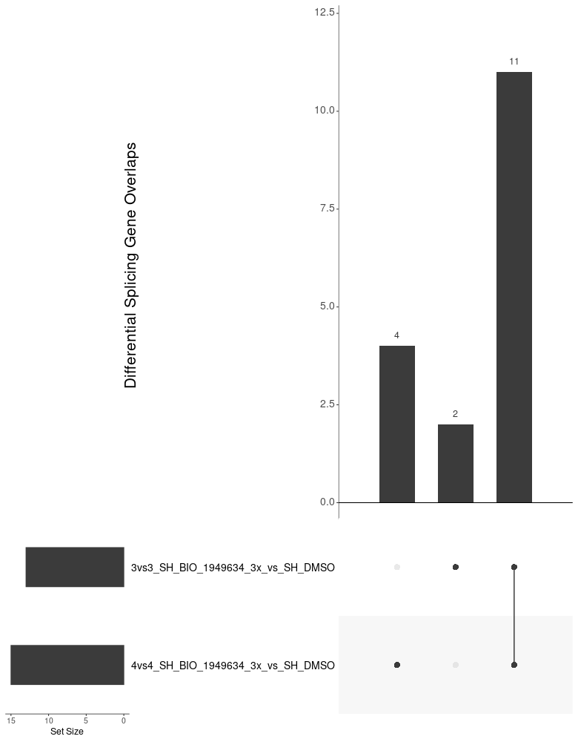
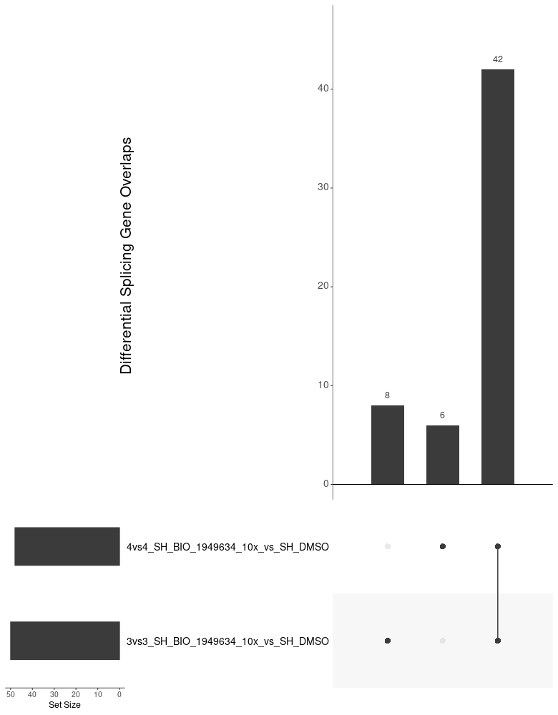
Overview of Compounds in ShSy5Y off-Targets overlap in risdiplam (within 3vs3 setting and cross 3vs3/4vs4 setting)
9/13 DSG induced by 3x Risdiplam were
Covered by 10x Risdiplam in 3vs3 setting
Most DSG induced by 3x Risdiplam
Are consistent across 3vs3 and 4vs4 setting
Super majority of the DSG induced by 10x Risdiplam
Are consistent across 3vs3 and 4vs4 setting

Slide 8
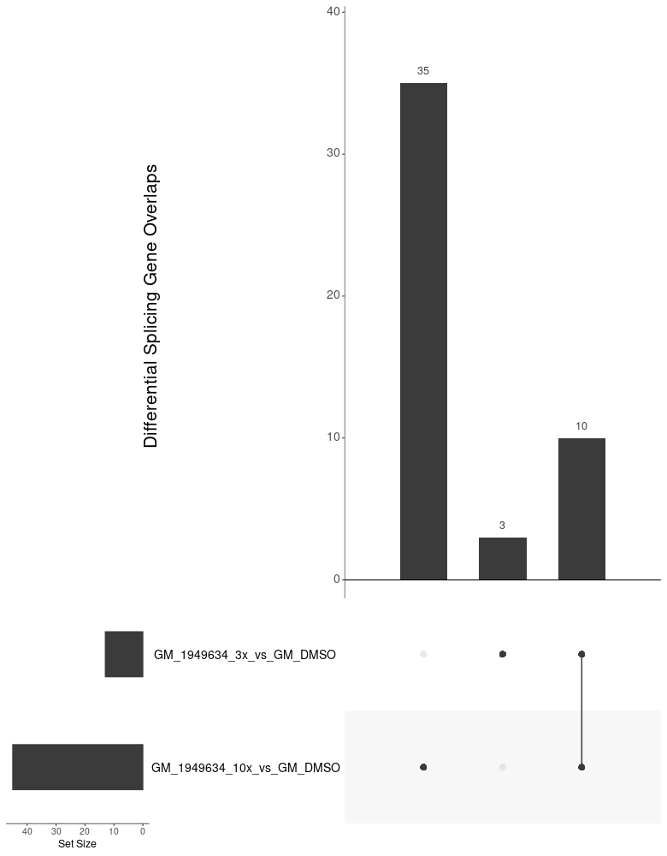
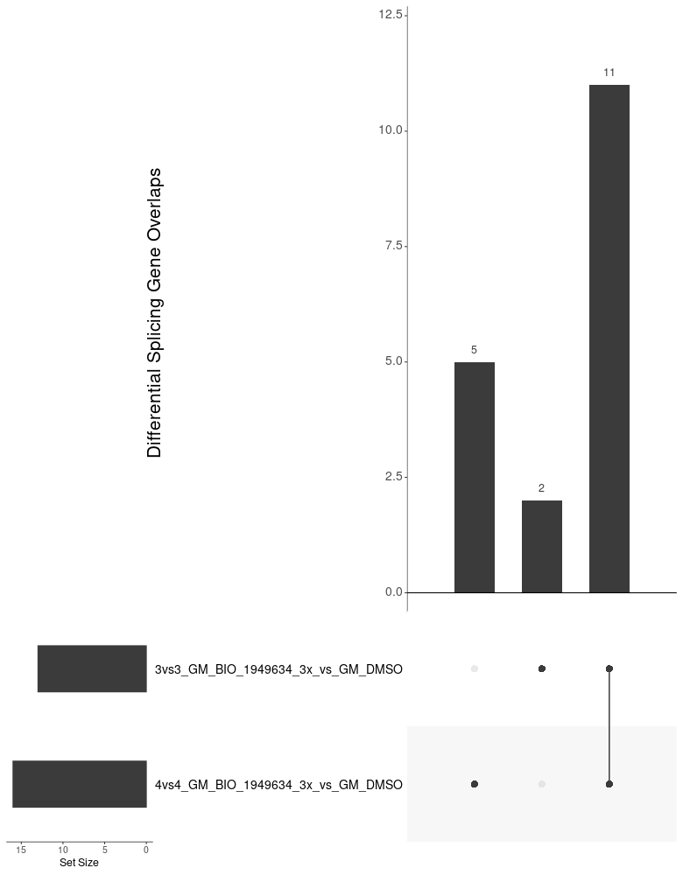

Overview of Compounds in GM09677c off-Targets overlap in risdiplam (within 3vs3 setting and cross 3vs3/4vs4 setting)
10/13 DSG induced by 3x Risdiplam were
Covered by 10x Risdiplam in 3vs3 setting
Most DSG induced by 3x Risdiplam
Are consistent across 3vs3 and 4vs4 setting
Super majority of the DSG induced by 10x Risdiplam
Are consistent across 3vs3 and 4vs4 setting

Slide 9
DSG dPSI in ShSy5Y max(abs(dPSI))
4vs4
3vs3
Comparison | HTT | SMN1 | SMN2
dPSI_SH_BIO_1949634_10x_vs_SH_DMSO | NA | -0.251542 | -0.4028676
dPSI_SH_BIO_1949634_03x_vs_SH_DMSO | NA | NA | -0.3424944
dPSI_SH_BIO_2178782_10x_vs_SH_DMSO | 0.33240197 | 0.4104 | -0.3834702
dPSI_SH_BIO_2178782_03x_vs_SH_DMSO | -0.3694164 | 0.4279 | -0.3811666
dPSI_SH_BIO_2196772_10x_vs_SH_DMSO | 0.54427119 | -0.2536106 | -0.4013308
dPSI_SH_BIO_2196772_03x_vs_SH_DMSO | -0.3446866 | 0.3769 | -0.3632981
dPSI_SH_BIO_2196895_10x_vs_SH_DMSO | -0.2536149 | 0.4796 | -0.3934613
dPSI_SH_BIO_2196895_03x_vs_SH_DMSO | NA | NA | -0.2893154
dPSI_SH_BIO_2197306_10x_vs_SH_DMSO | 0.34409763 | 0.4796 | -0.3940991
dPSI_SH_BIO_2197306_03x_vs_SH_DMSO | NA | NA | -0.3173035
dPSI_SH_BIO_2199562_10x_vs_SH_DMSO | 0.32487121 | NA | -0.3549552
dPSI_SH_BIO_2199562_03x_vs_SH_DMSO | 0.25555825 | NA | -0.3265951
dPSI_SH_BIO_2204984_10x_vs_SH_DMSO | -0.3318012 | 0.3782 | -0.3607647
dPSI_SH_BIO_2204984_03x_vs_SH_DMSO | NA | NA | NA
dPSI_SH_BIO_2207180_10x_vs_SH_DMSO | NA | NA | -0.2540779
dPSI_SH_BIO_2207180_03x_vs_SH_DMSO | NA | NA | NA
Comparison | HTT | SMN1 | SMN2
dPSI_SH_BIO_1949634_10x_vs_SH_DMSO | NA | -0.2526652 | -0.3973348
dPSI_SH_BIO_1949634_03x_vs_SH_DMSO | NA | NA | -0.3357675
dPSI_SH_BIO_2178782_10x_vs_SH_DMSO | 0.58181829 | 0.3746 | -0.3718549
dPSI_SH_BIO_2178782_03x_vs_SH_DMSO | -0.3768796 | 0.4252 | -0.3774074
dPSI_SH_BIO_2196772_10x_vs_SH_DMSO | 0.84293755 | -0.25527 | -0.3969779
dPSI_SH_BIO_2196772_03x_vs_SH_DMSO | 0.27077417 | 0.3761 | -0.3575137
dPSI_SH_BIO_2196895_10x_vs_SH_DMSO | -0.3125544 | 0.4767 | -0.3901281
dPSI_SH_BIO_2196895_03x_vs_SH_DMSO | NA | NA | -0.2865837
dPSI_SH_BIO_2197306_10x_vs_SH_DMSO | 0.38282796 | 0.4767 | -0.3888403
dPSI_SH_BIO_2197306_03x_vs_SH_DMSO | NA | NA | -0.3108891
dPSI_SH_BIO_2199562_10x_vs_SH_DMSO | 0.47217337 | 0.3791 | -0.3606088
dPSI_SH_BIO_2199562_03x_vs_SH_DMSO | 0.2825576 | NA | -0.3230936
dPSI_SH_BIO_2204984_10x_vs_SH_DMSO | -0.3590067 | 0.3925 | -0.3594403
dPSI_SH_BIO_2204984_03x_vs_SH_DMSO | NA | NA | NA
dPSI_SH_BIO_2207180_10x_vs_SH_DMSO | NA | NA | -0.2673572
dPSI_SH_BIO_2207180_03x_vs_SH_DMSO | NA | NA | NA

Slide 10
DSG dPSI in ShSy5Y on-Targets
4vs4
3vs3
Comparison | HTT | SMN1 | SMN2
dPSI_SH_BIO_2178782_10x_vs_SH_BIO_1949634_10x | NA | NA | NA
dPSI_SH_BIO_2178782_03x_vs_SH_BIO_1949634_03x | -0.357 | NA | NA
dPSI_SH_BIO_2196772_10x_vs_SH_BIO_1949634_10x | 0.792 | NA | NA
dPSI_SH_BIO_2196772_03x_vs_SH_BIO_1949634_03x | 0.258 | NA | NA
dPSI_SH_BIO_2196895_10x_vs_SH_BIO_1949634_10x | NA | NA | NA
dPSI_SH_BIO_2196895_03x_vs_SH_BIO_1949634_03x | NA | NA | NA
dPSI_SH_BIO_2197306_10x_vs_SH_BIO_1949634_10x | 0.422 | NA | NA
dPSI_SH_BIO_2197306_03x_vs_SH_BIO_1949634_03x | NA | NA | NA
dPSI_SH_BIO_2199562_10x_vs_SH_BIO_1949634_10x | 0.536 | NA | NA
dPSI_SH_BIO_2199562_03x_vs_SH_BIO_1949634_03x | 0.270 | NA | NA
dPSI_SH_BIO_2204984_10x_vs_SH_BIO_1949634_10x | -0.303 | NA | NA
dPSI_SH_BIO_2204984_03x_vs_SH_BIO_1949634_03x | NA | NA | NA
dPSI_SH_BIO_2207180_10x_vs_SH_BIO_1949634_10x | NA | NA | NA
dPSI_SH_BIO_2207180_03x_vs_SH_BIO_1949634_03x | NA | NA | NA
Comparison | HTT | SMN1 | SMN2
dPSI_SH_BIO_2178782_10x_vs_SH_BIO_1949634_10x | NA | NA | NA
dPSI_SH_BIO_2178782_03x_vs_SH_BIO_1949634_03x | -0.357 | NA | NA
dPSI_SH_BIO_2196772_10x_vs_SH_BIO_1949634_10x | 0.792 | NA | NA
dPSI_SH_BIO_2196772_03x_vs_SH_BIO_1949634_03x | 0.258 | NA | NA
dPSI_SH_BIO_2196895_10x_vs_SH_BIO_1949634_10x | NA | NA | NA
dPSI_SH_BIO_2196895_03x_vs_SH_BIO_1949634_03x | NA | NA | NA
dPSI_SH_BIO_2197306_10x_vs_SH_BIO_1949634_10x | 0.422 | NA | NA
dPSI_SH_BIO_2197306_03x_vs_SH_BIO_1949634_03x | NA | NA | NA
dPSI_SH_BIO_2199562_10x_vs_SH_BIO_1949634_10x | 0.536 | NA | NA
dPSI_SH_BIO_2199562_03x_vs_SH_BIO_1949634_03x | 0.270 | NA | NA
dPSI_SH_BIO_2204984_10x_vs_SH_BIO_1949634_10x | -0.303 | NA | NA
dPSI_SH_BIO_2204984_03x_vs_SH_BIO_1949634_03x | NA | NA | NA
dPSI_SH_BIO_2207180_10x_vs_SH_BIO_1949634_10x | NA | NA | NA
dPSI_SH_BIO_2207180_03x_vs_SH_BIO_1949634_03x | NA | NA | NA

